Slide 1
Lecture 11: CT Reconstruction – Iterative Algorithms
Dr. Guohua Cao （曹国华） caogh@shanghaitech.edu.cn
School of Biomedical Engineering
ShanghaiTech University
4/23/2024

Slide 2
Lecture 11: CT Reconstruction – Iterative Algorithms
An example of reconstruction by direct solver
Limitation of direct solver
General procedure of iterative reconstruction
Examples of iterative reconstruction algorithm

Slide 3
Problem to solve: Computed Tomography with discrete measurements
Discrete Measurements
Continuous Unknown Image

Slide 4
p₁
p₂
⎡1 0 1
⎢ 1 0
⎢1 1 0
⎣0 0 1
0⎤⎡ x ⎤
⎡ p ⎤
⎢₀
1
1
₁⎥⎢_{x} ⎥ ⎢ _{p} ⎥
⎥⎢ ² ⎥ ₌ ⎢
2 ⎥
x₁ | x₂
x₃ | x₄
0⎥⎢x₃ ⎥ ⎢ p₃ ⎥
p₃
⎢
⎥⎢ ⎥ ⎢ ⎥
¹⎦⎣^{x}4 ⎦ ⎣ ^{p}4 ⎦
p₄
AX=P

Slide 5
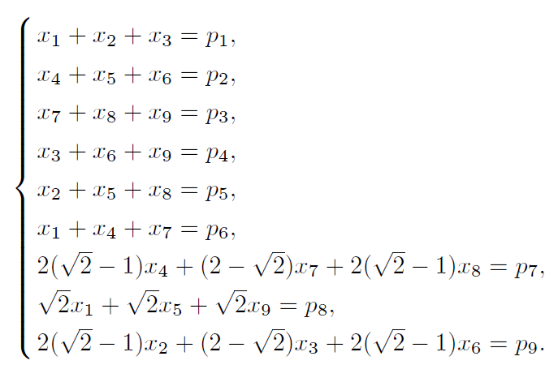
System of Linear Equations

Slide 6
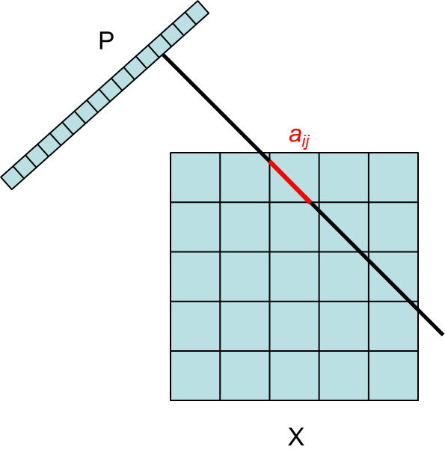
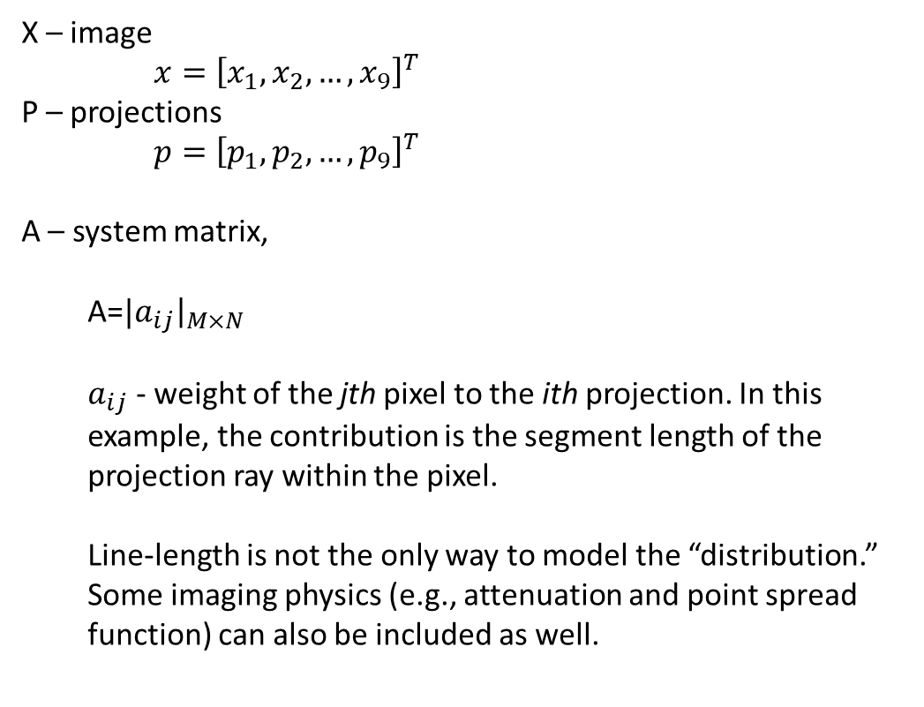


$$AX=P$$
X – image
$x={\left[x_{1},x_{2},…,x_{9}\right]}^{T}$
P – projections
$p={\left[p_{1},p_{2},…,p_{9}\right]}^{T}$
A – system matrix,
A=${|a}_{ij}{\left.​\right|}_{M×N}$
$a_{ij}$ - weight of the jth pixel to the ith projection. In this example, the contribution is the segment length of the projection ray within the pixel.
Line-length is not the only way to model the “distribution.” Some imaging physics (e.g., attenuation and point spread function) can also be included as well.
$$A=\left[\begin{matrix}a_{11} & ⋯ & a_{19} \\ ⋮ & ⋱ & ⋮ \\ a_{91} & ⋯ & a_{99}\end{matrix}\right]$$
Should be 3x3 image grid

Slide 7
Solving AX=P
In practice, A is not invertible (not square, or not full rank)
A generalized inverse is used X = A†P
Moore-Penrose inverse A†=(A^{T}A)⁻¹A^{T}
AA†A=A
A†AA†=A†
Least-squares solution (Gaussian noise model)

Slide 8
Least Square Solution
When the system is over-determined, that is, (1)M>=N and (2) The rank of A is N, we can have a least square solution:
f ∗= arg min(Af − g)^{T} (Af − g) = (A^{T} A)⁻¹ (A^{T} g)
f
For ideal case, there is no noise and we have the exact solution: f ∗= f

Slide 9
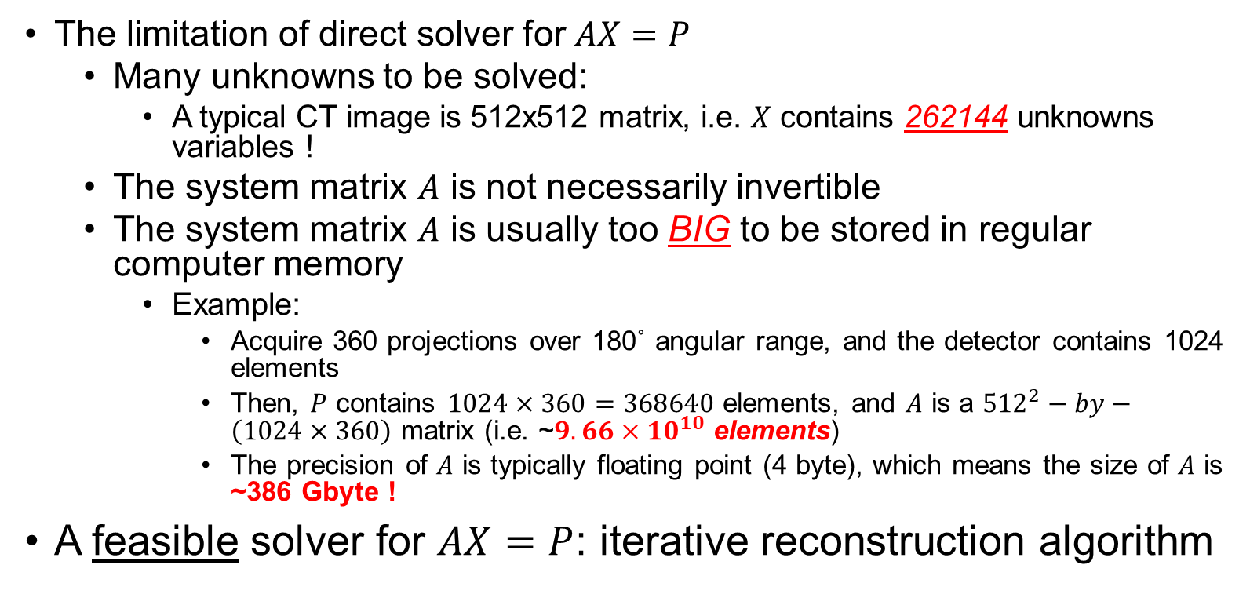
Limitation of direct solver
The limitation of direct solver for $AX=P$
Many unknowns to be solved:
A typical CT image is 512x512 matrix, i.e. $X$ contains 262144 unknowns variables !
The system matrix $A$ is not necessarily invertible
The system matrix $A$ is usually too BIG to be stored in regular computer memory
Example:
Acquire 360 projections over 180˚ angular range, and the detector contains 1024 elements
Then, $P$ contains $1024×360=368640$ elements, and $A$ is a ${512}^{2}−by−\left(1024×360\right)$ matrix (i.e. ~$9.66×{10}^{10}$ elements)
The precision of $A$ is typically floating point (4 byte), which means the size of $A$ is ~386 Gbyte !
A feasible solver for $AX=P$: iterative reconstruction algorithm

Slide 10
Trial & Error
6
4
Error
0
0
4
3
3
2
Guess 1
0
0
2
1
3
2
Guess 0
4
3
2
Guess 2
Update a guess based on data differences
−2
Error
2
1

Slide 11
Iterative Algorithms
For example, ML-EM, OS-EM,
P
ART, GC, …
Discretize the image into pixels
Solve imaging equations AX=P iteratively
ªij
X = unknowns (pixel values)
P = projection data
A = imaging system matrix
X

Slide 12
The most significant motivation of using an iterative algorithm:
Usually, iterative algorithms give better reconstructions than analytical algorithms.

Slide 13


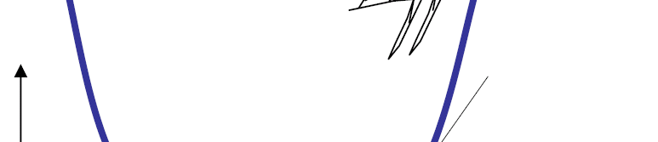
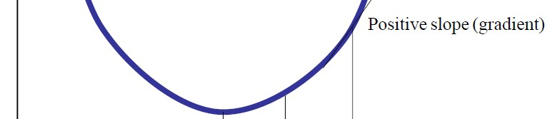
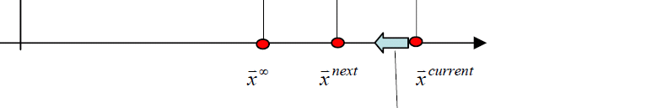
Gradient Descent Algorithms
Idea of GDA: The main idea of gradient descent algorithms is to evaluate the gradient of the object function and use the gradient information to find the minimum of the objective function.
One variable example
Φ(x)
_{x}∞
_{x}next
_{x}current
f ∗= arg min(Af − g)^{T} (Af − g) = arg min Af − g ² = arg min Φ(f )
f f f
_{f} next _{= f} current
λ ^{current} ∇Φ(f ^{current} ), ∇ Af − g ² = 2A^{T} (Af − g )
G. L. Zeng, Medical Imaging Reconstruction- A conceptual tutorial; Higher Education Press, 2009.

Slide 14
Gradient Descent Algorithms
Reconstruction Formula
_{f} next _{= f} current _{− λ} current _{A}T _{(Af} current
− g )
The parameter Lambda usually should be empirically selected. General speaking, the larger the lambda, the faster the convergence. However, a over large lambda may result in a divergent result.
In one iteration, all the measured datasets will be used. It included a forward projection and a backprojecton procedure.
The negative gradient direction may not be the optimal direction to use in finding the solution. A better searching direction is to use the concept of conjugate direction, which makes the algorithm converge faster.

Slide 15
Algebraic Approach
Convert X-ray data into line integrals to form a system of linear equations
Solve the system of linear equations to reconstruct an underlying image
Regularize the image reconstruction with various prior knowledge
Iteratively refine an intermediate image until the outcome is satisfactory

Slide 16

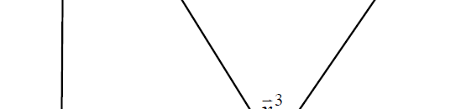
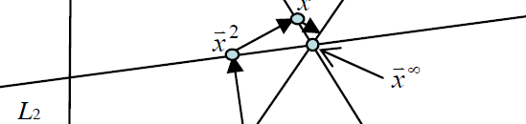
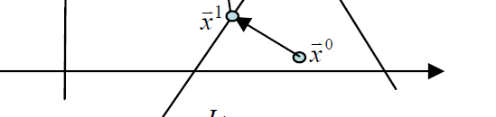
ART
Idea of ART: The main idea of algebraic reconstruction technique (ART) is to make the estimated image satisfy one equation at a time.
Example:
3 equations (3 Lined L1, L2, L3)
2 pixels (2D vector in 2D space)
_{f} 3
_{f} 2
_{f} ∞
_{f} 1
_{f} 0
Reference: Herman, Lent and Rowland; ART: Mathematics and Applications-- A report on the Mathematical Foundations and on the Applicability to Real Data of the Algebraic Reconstruction Techniques, Journal of Theoretical Biology, 42:1-32, 1973.

Slide 17

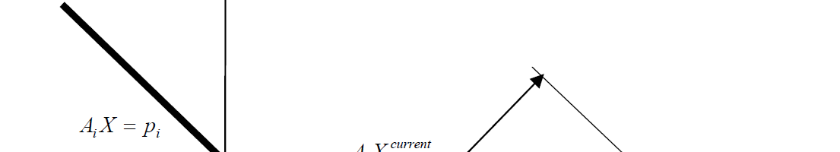
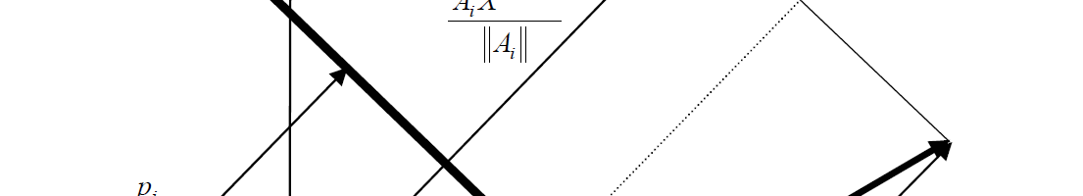
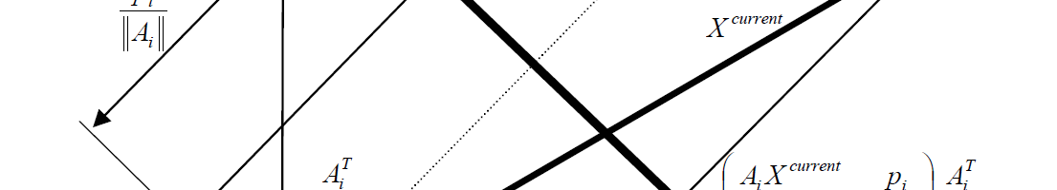
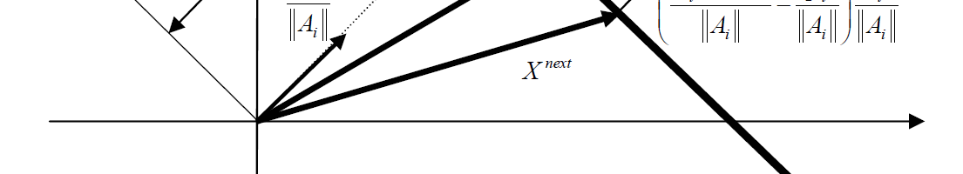
ART Reconstruction Formula
_{A f} current _{− g}
next current
m m
2
T
m
f = f
A
A
m
_{current − ⎛ A f} current
g
_{⎞ A}T
= f
m
⎜
−
m m
⎟
_{A f} current
⎝
A_{m}
A_{m ⎠} A_{m}
A_{m}f = g_{m}
m
Derivation :
A^{T} •f = g
A_{m}
m m
_{A}T
f = f − δ ^{m} , A_{m}f
next current
_{A}T
next
= g_{m}
g_{m}
m
A
_{f} current
⎛
_{A}T
⎞
m
A_{m} ⎜ f
current
− δ ^{m} ⎟ = g_{m}
⎜
_{A}T
⎟
⎝
m
⎠
_{A}T
T
2
_{⎛ A f} current
g
_{⎞ A}T
A A = A
⇔ A f
current
− δ A
T
m
= g
m
⎜ ⁻ ⎟
m m m
m m m
m
m
A_{m}
A_{m}
2
= A^{T}
_{A f} current _{− g}
⎝ ^{Am} ⎠ ^{Am}
m
_{⇔ δ =} m m
_{f} next
A_{m}

Slide 18
SIRT
Idea of SIRT: The simultaneous iterative reconstruction technique (SIRT) is similar to ART. While in each iteration, ART only consider one measured data, SIRT consider all the measured datasets.
W ∈ R^{M} × R^{M} be a diagonal matrix
M _{A f} current _{− g}
next current
∑
T
m
1 1
f = f −
m m
2
A
with w =
=
m=1
A
m
mm
A_{m}
2 N
∑ m,n
_{= f} current _{− AW Af} current _{− g}
a
2
n=1
Remarks:
At the early development of ART and SIR, the measurement matrix was approximated as a binary matrix for fast computation, that is, a_{mn} can only be only “0” or “1”.
Compared with the GDA, the SIRT has one additional weighting step to normalize the projection difference. As a result, the relaxation parameter lambda can be viewed as a constant 1.
A relaxation parameter in a range of [0,2] can also be multiplied to the error correction term to control the convergence speed.
Reference: Gilbert P, Iterative methods for three-dimensional reconstruction of an object from projections.
Journal of Theoretical Biology, 36:105-117, 1973.

Slide 19
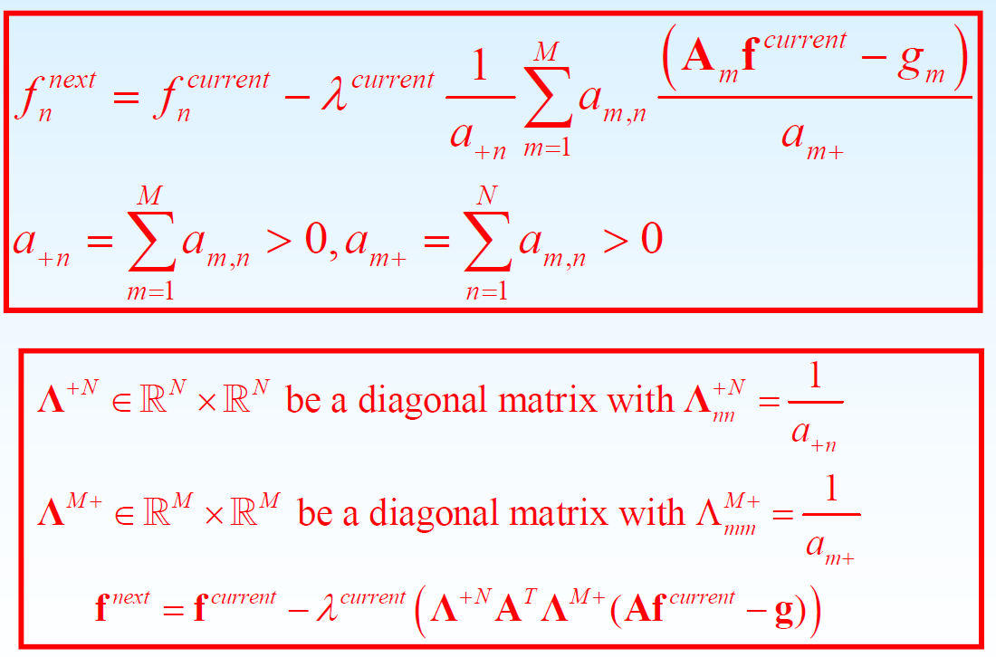
SART
Idea of SART: The simultaneous algebraic reconstruction technique (SART) is similar to SIRT. It is a major refinement to ART and SIRT.
A : mth row of the matrix A
m
0 < λ <2: Relaxation parameter
current
Gradient Descrent Algorihtm
_{f} next _{= f} current _{− λ} current _{A}T _{(Af} current _{− g )}
Compared with the GDA, the SART has two additional weighting steps to normalize the projection difference and the backprojection image, which are done before and after the backprojection produce. As a result, the relaxation parameter lambda has a clear convergence range [0,2].
Reference: Andersen and Kak, Simultaneous algebraic reconstruction technique (SART): A superior implementation of the ART algorithm, Ultrasonic Imaging, 6:81-94, 1984.

Slide 20
Remarks on SIRT and SART:
Compared to the GDA, SIRT and SART have additional weighting operations to normalize the intermediate results and a clear convergence range for the relaxation parameter. However, the relaxation parameter for GDA has to be empirically selected.
Compared to the SIRT, while SIRT use a L2-norm of the x-ray path length to normalize the intermediate results, SART use a L1-norm to normalize the intermediate results.
Ordered-subset (OS) or block iterative algorithm can be used to accelerate the SIRT and SART algorithm and results in the OS-SIRT and OS-SART algorithm. The idea is to divide all the measured datasets into several non-overlapped and nonempty subsets. In one iteration, all the data in a specific subset will be used. OS-SIRT/SART somehow can be viewed as a compromise of using the dataset between ART and SIRT/SART.

Slide 21

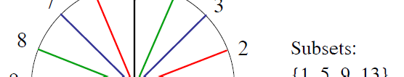
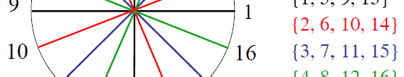

OS-Strategy
OS is an acceleration strategy, There are many strategies to divide the measured datasets into subsets.
Increasing the number of subsets can accelerate the convergence rate but may increase the noise as well.
Roughly speaking, if we have Q subsets, we can accelerate the
corresponding iterative algorithms Q times.
An OS example for 16 projections
(4) Modest acceleration of approximately 10 times is possible with very little increase in noise.

Slide 22
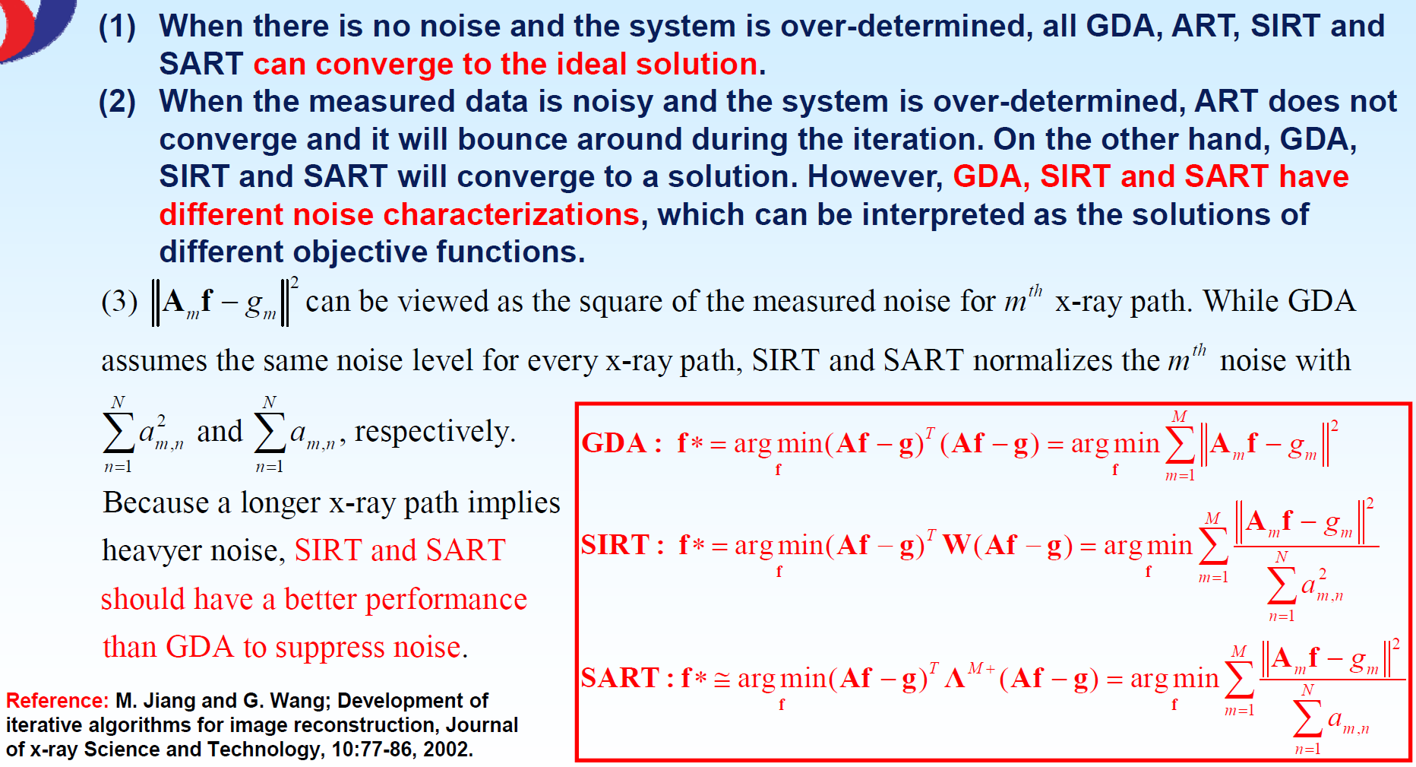
Comparison of GDA, ART, SIRT and SART

Slide 23
Why are iterative algorithms better than analytical algorithms?
The system matrix A is more flexible than the assumptions in an analytical algorithm
It is a lot harder for an analytical algorithm to handle some realistic situations

Slide 24
Analytic algorithm — “Open-loop system”
Data
Filtering
Backprojection
Image

Slide 25
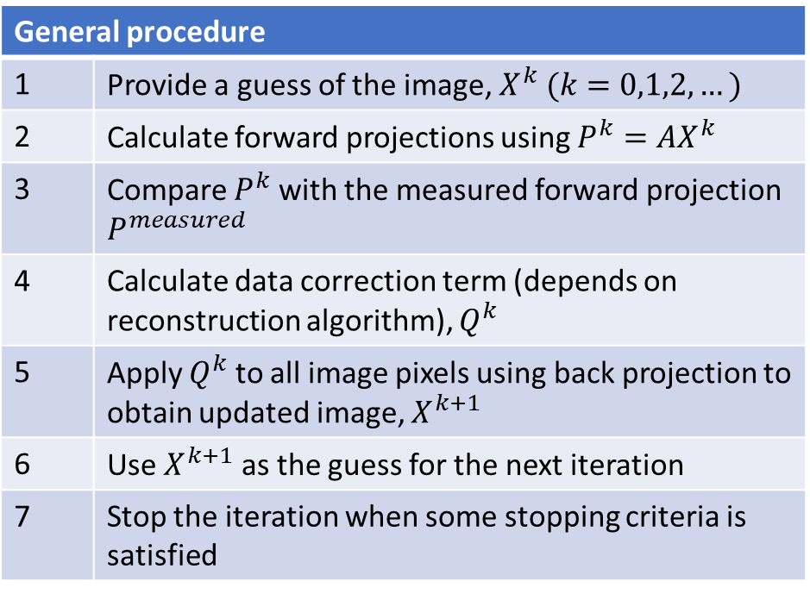
Iterative algorithm — “Closed-loop system”
General procedure
1 | Provide a guess of the image, $X^{k} (k=0,1,2,…)$
2 | Calculate forward projections using $P^{k}=AX^{k}$
3 | Compare $P^{k}$ with the measured forward projection $P^{measured}$
4 | Calculate data correction term (depends on reconstruction algorithm), $Q^{k}$
5 | Apply $Q^{k}$ to all image pixels using back projection to obtain updated image, $X^{k+1}$
6 | Use $X^{k+1}$ as the guess for the next iteration
7 | Stop the iteration when some stopping criteria is satisfied

Slide 26
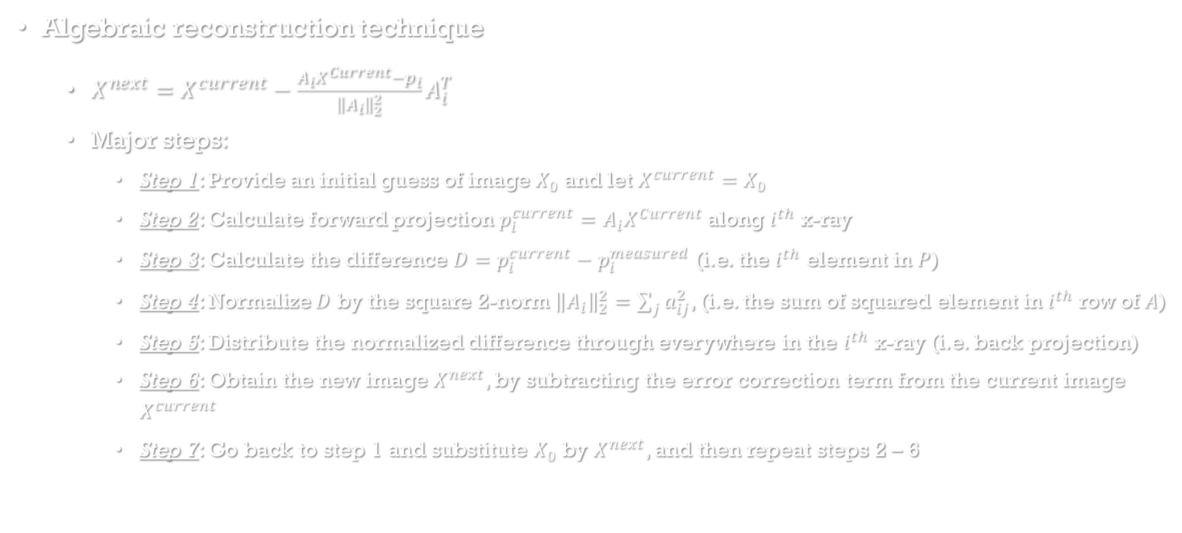
An example of iterative reconstruction algorithm
Algebraic reconstruction technique
$X^{next}=X^{current}−\frac{A_{i}X^{Current}−p_{i}}{{\left\|A_{i}\right\|}_{2}^{2}}A_{i}^{T}$
Major steps:
Step 1: Provide an initial guess of image $X_{0}$ and let $X^{current}=X_{0}$
Step 2: Calculate forward projection $p_{i}^{current}=A_{i}X^{Current}$ along $i^{th}$ x-ray
Step 3: Calculate the difference $D=p_{i}^{current}−p_{i}^{measured}$ (i.e. the $i^{th}$ element in $P$)
Step 4: Normalize $D$ by the square 2-norm ${\left\|A_{i}\right\|}_{2}^{2}=\sum_{j}{a_{ij}^{2}}$, (i.e. the sum of squared element in $i^{th}$ row of $A$)
Step 5: Distribute the normalized difference through everywhere in the $i^{th}$ x-ray (i.e. back projection)
Step 6: Obtain the new image $X^{next}$, by subtracting the error correction term from the current image $X^{current}$
Step 7: Go back to step 1 and substitute $X_{0}$ by $X^{next}$, and then repeat steps 2 – 6
Error correction term
Calculation of
Error correction term

Slide 27
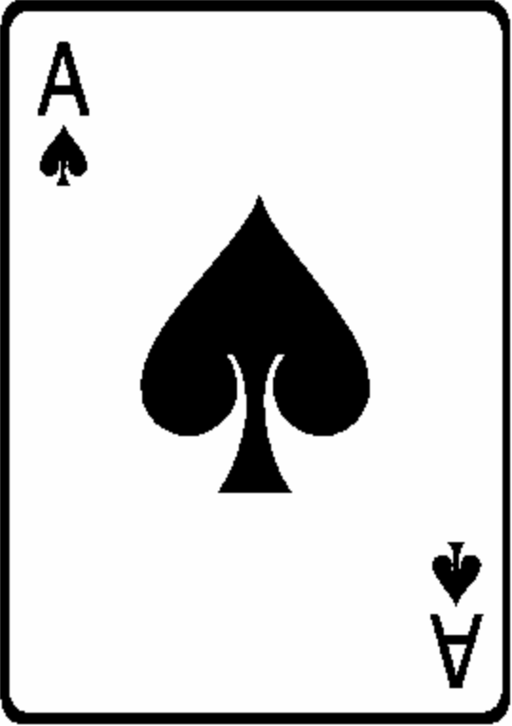
Main Difference: Analytic vs. Iterative
Analytic algorithms do not have a projector A, but have a set of assumptions.
Iterative algorithms have a projector A.

Slide 28

Noise in CT Reconstruction
$$AX=P+e$$
Iterative: Objective function (e.g., Likelihood)
Iterative: Regularization (very effective!)
Analytic: Filtering (assumes spatially invariant, not as good)

Slide 29
Modeling noise in an iterative algorithm (thus Statistical Algorithm)
Example: A one-pixel image (i.e., total count is the only concern)
3 measurements:
1100 counts for 10 sec. (110/s)
100 counts for 1 sec. (100/s)
3) 15000 counts for 100 sec. (150/s)
Counts per second?

Slide 30
m₁ = 1100, σ²(m₁)=1100,
x₁=1100/10=110,
σ²(x₁)= σ²(m₁)/(10)² = 1100/100=11
m₂ = 100, σ²(m₂)=100,
x₂=100/1=100,
σ²(x₂)= σ²(m₂)= 100
m₃ = 15000, σ²(m₃)=15000,
x₃=15000/100=150,
σ²(x₃)= σ²(m₃)/(100)² = 15000/10000=1.5

Slide 31
Objective Function
(x − x )² (x − x )² (x − x )²
_{F =} 1 ₊ 2 ₊ 3
σ (x )
σ (x )
σ (x )
2
2
2
1
2
3
(x − 110)²
(x − 100)²
(x − 150)²
F =
+ +
11 100 1.5
dF ₌ 2(x − 110) ₊ 2(x − 100) ₊ 2(x − 150) ₌ ₀
dx 11 100 1.5
110 ₊ 100 ₊ 150
_{x =} 11 100 1.5 _{= 144.61}
1 ₊ 1 ₊ 1
11 100 1.5

Slide 32
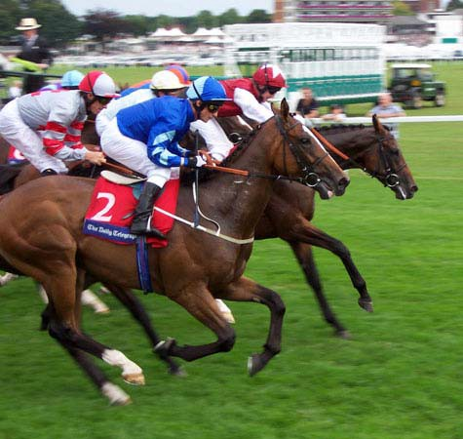
Generalization
If you have N unknowns, you need to make a lot more than N measurements.
The measurements are redundant.
Put more weights on the measurements that you trust more.

Slide 33
Regularization & Constraints
Helpful constraints:
Non-negativity (x_{i} ≥ 0)
Image support (x_{k} = 0, x in K)
Bounds of values (e.g. transmission map) Data consistency conditions
Prior

Slide 34

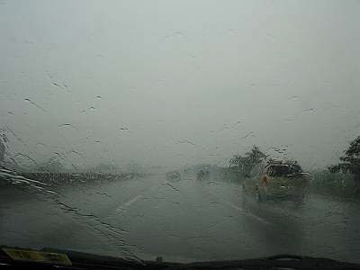
Regularization using Prior
What is a prior?
Example:
You want to estimate tomorrow’s temperature.
You know today’s temperature.
You assume that tomorrow’s temperature is pretty close to today’s

Slide 35
How to select a prior?
Not easy. It is an art.
V
Example:
Noise model
Prior encouragement
Data matching
∑
i
1
( A X − p ) + λ∑V (x − x )
F =
2
σ
2
i
i
i i j
If V(x) = x², it enforces smoothness.

Slide 36
Edge Preserving Prior
∑
i
1
( A X − p ) + λ∑V (x − x )
F =
2
σ
2
i
i i i j
V(x)
If V(x) = |x|, it preserves edges and reduces noise.
x

Slide 37
How does V know where is the edge?
∑
1
( A X − p ) + λ∑V (x − x )
F =
2
σ
2
i
i i i j
i
V(x) = |x| increases a lot slower than V(x) = x².
V(x) = |x| treats small jumps as noise to suppress and large jumps as edges not to suppress as much.
V(x)
x
The shape of V(x) is important.

Slide 38
What is an ML algorithm?
An algorithm that maximizes the likelihood function.

Slide 39
Example: Gaussian Noise
A likelihood function is a conditional probability
2 2
L( X ) = Pr(P | X ) = Πe
Take log
−( A X − p ) /(2
σ )
i i
i
l( X ) = −∑
( A X − p )
2
i i
σ
2
i
Thus maximize the likelihood function L(X) is equivalent to Least-Squares Problem
F ( X ) = ∑
( A X − p )
2
i i
σ
2
i

Slide 40
Least-Squares = ML for Gaussian
∑
( A X − p )
2
An algorithm that minimizes
F ( X ) =
i i
σ
2
i
is an ML algorithm for independent Gaussian noise
One can set up a Poisson likelihood function and find an ML algorithm for that. The well- known ML-EM algorithm is one of such algorithms.

Slide 41
What is a MAP algorithm?
MAP = maximum a posteriori
An algorithm that maximizes the likelihood function with a prior
For example, an algorithm that minimizes the following objective function is a MAP algorithm
∑
i
1
( A X − p ) + λ∑V (x − x )
F =
2
σ
2
i
i i i j

Slide 42
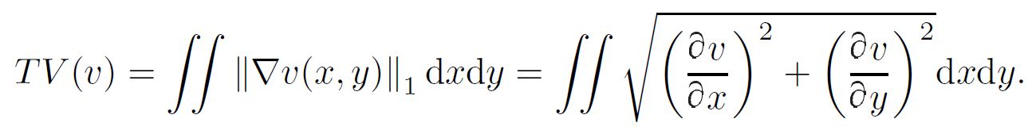
TV Regularization
The TV (Total Variation) norm of an image v(x,y) is the integral of the l1-norm of the gradient of the image.
TV-SART
SART with TV regularization

Slide 43
Iterative Methods Summary
Can incorporate
Imaging physics
Irregular imaging geometry
Prior information
Count preserving
But
It is an art to set things up
Complex
Long computation time
Bias

Slide 44
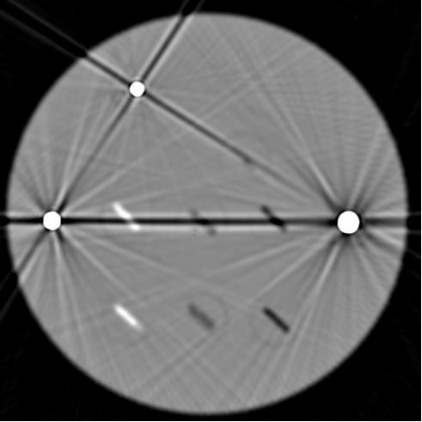
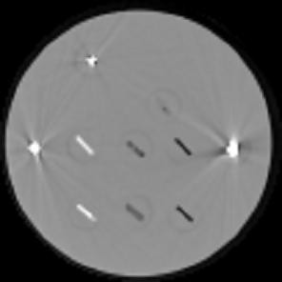
Iterative Reconstruction Example: Missing data : MAR
FBP
IR
treat all rays equally
pre-correct for physics
lower weight to corrupted rays
incorporate physics
B De Man, IEEE Trans. Nucl. Sci., 2000

Slide 45
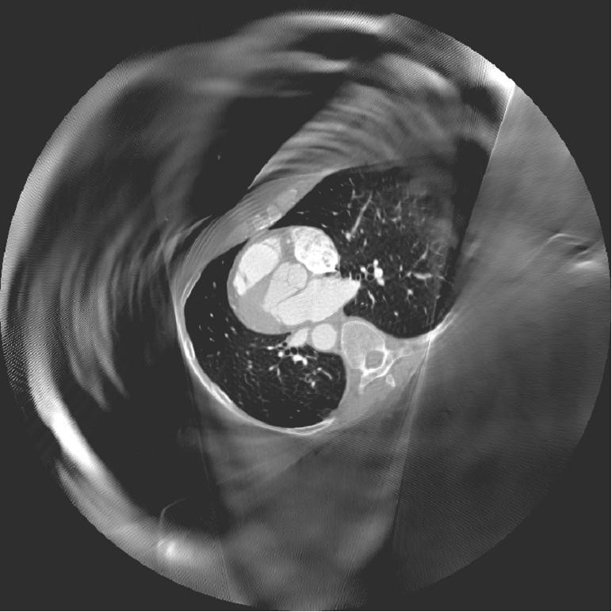
Iterative Reconstruction Example: Missing data : truncation or local ROI
Right Atrium
RCA
Left Atrium
Right ventricle
Aortic Valve
Pulmonary Vein
Descending Aorta
Exact reconstruction not possible for the pure local ROI case, Exact reconstruction IS possible with some extra information
D Langan, SPIE, 2006

Slide 46
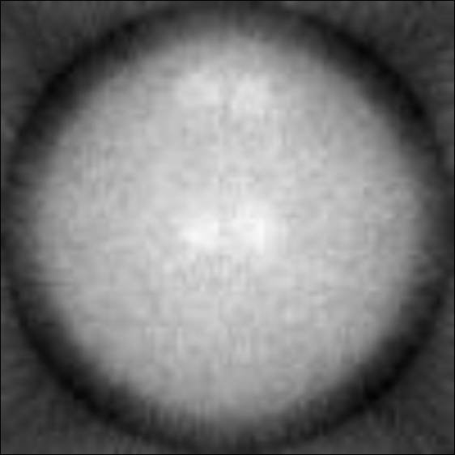
Iterative Reconstruction
An Example (ML-EM)

Slide 47
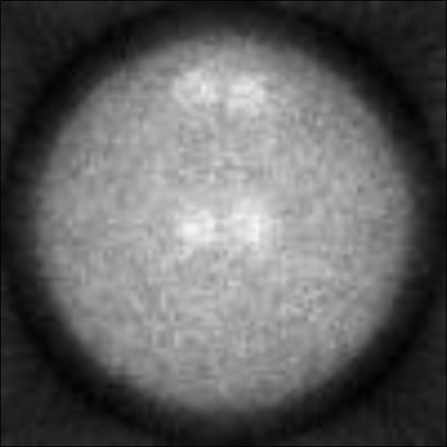
Iterative Reconstruction
An Example (ML-EM)

Slide 48
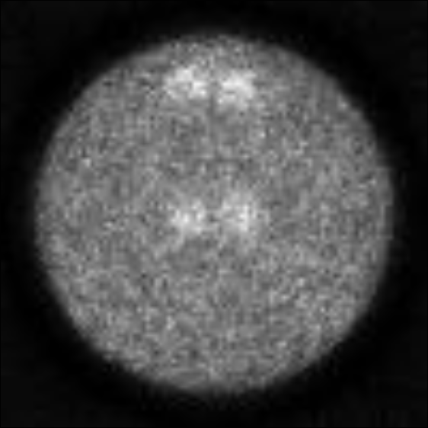
Iterative Reconstruction
An Example (ML-EM)

Slide 49
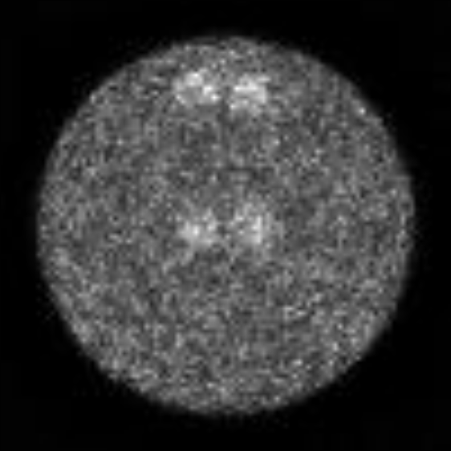
Iterative Reconstruction
An Example (ML-EM)

Slide 50
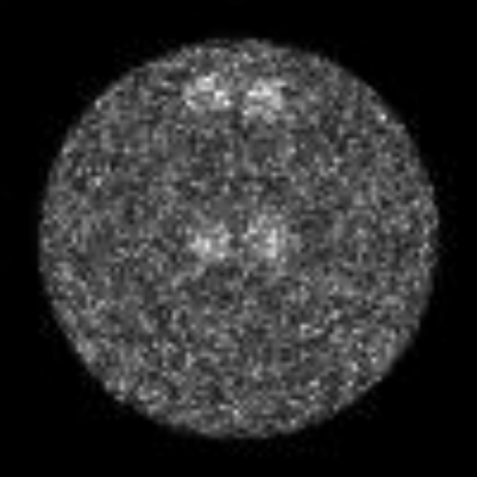
Iterative Reconstruction
An Example (ML-EM)

Slide 51
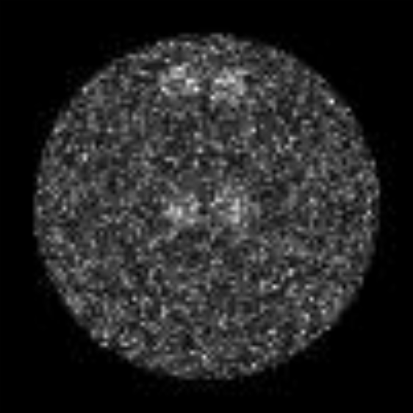
Iterative Reconstruction
An Example (ML-EM)

Slide 52
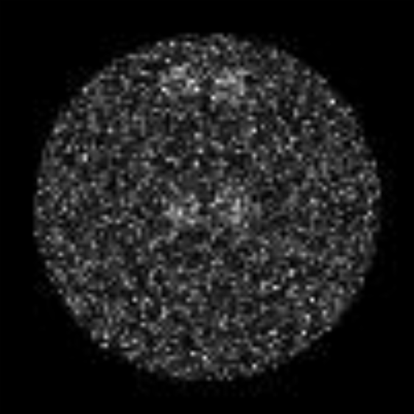
Iterative Reconstruction
An Example (ML-EM)

Slide 53
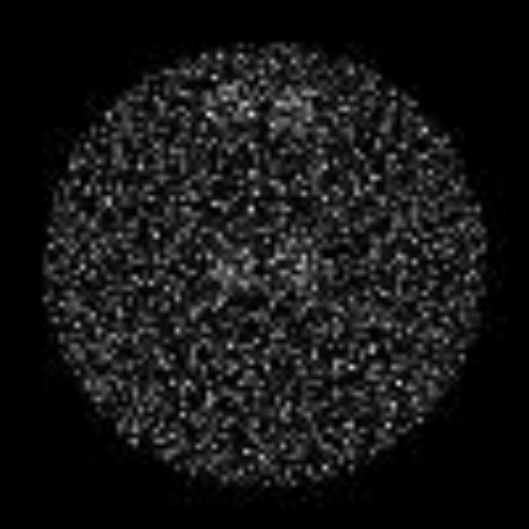
Iterative Reconstruction
An Example (ML-EM)

